Slide 1
Ever Health Technology Plan
Presented by: Eagle Consulting

Slide 2
Project Description
Brief description of the project

Slide 3
ABOUT US
Eagle Consultants has been providing technological solutions to real world business problems for over 20 years. Founded in 1995 with the goal of assisting businesses stay up to date with the technological world around them, Eagle Consultants quickly found itself as an essential “middle man” during the technological boom of the late 90’s and early 2000’s, bringing the latest developments in Information Technology to the average business. Big business has since moved towards these technological advancements, cutting down the need for IT interaction outside their companies. Yet, Eagle Consultants still finds itself enjoying the ability to bring close, personalized service to the companies who need it most, the companies that work hard but find themselves in need of more effective technology solutions. These are the people we are eager to aid.

Slide 4
Mission / Vision
Our mission is simple, to stay up to date on current IT developments so that we may provide the most effective solution for your specific business needs. We know that there is no single fix to the issues from business to business, and we know that your company is unique, with a specific role to fill. We aim to provide a fast, efficient, and most importantly effective IT answer that will not only save you time and money, but also have a positive effect on the clientele you closely interact with.
Our Vision is to facilitate an ever increasing amount of Information Technology Solutions. The technological world is ever changing and our desire is to constantly learn and develop new techniques. Our aim is to be the best at understanding what makes your company special, so that we may have the best Information Technology solution for you!

Slide 5
OUR CLIENT – EVER HEALTH FITNESS
Ever Health Fitness is a chain of fitness centers operating in the state of Ohio. These Centers operate 24/7 for personal fitness.
In 1973 two retired coaches, Hennery Truman and Michael Hatch opened the first center in Dayton Ohio. Several other locations were added with ten years and the chain expanded to suburban communities in other metropolitan areas across several cities in Ohio.
Today Ever healthy fitness consists of twenty two gyms with an estimated 20,000 members across the State. Ever Health facilities include locker rooms, pools, children club where kids play with the supervision of their parents. For the last five years Ever Health introduced new equipment such as free weights, weight machines, stability devices, cardiovascular equipment and fitness classes. Ever Health not only includes equipment and technology but also an atmosphere, view, innovation, tradition and uniqueness.

Slide 6
EVER HEALTH MISSION STATEMENT
Our goal is to provide an environment that promotes accessibility to fitness equipment and knowledge to anyone that needs it. We aim to provide the tools necessary to start and maintain a healthy lifestyle, all while providing a comfortable and welcome environment.

Slide 7
EVER HEALTH ORGANIZATIONAL CHART
Jason Zander President & CEO
Lawrie Gaffney Accounting
Patrick lliott VP Finance
Lola Jacobsen Operation
Olivier Renaud Team Director
Spencer Lowe Regnional Manager
Of 7 Locations
Mike Danselio Regional Manager
Of 8 Locations
Prashanth Desai Regional Manager
Of 7 Locations
Szabolcs Vajda Human Resources Head
Jason Kozleski VP Human Resources
Pat Coleman VP Customer Svc

Slide 8
THE PROBLEM
The Ever Health Website is outdated and lacks any type of client functionality. All information is stored locally and only at specific locations. It is very difficult to share information across gyms.
Currently customers must travel to the main regional gym locations to renew or cancel their membership. They cannot cancel or renew their membership at any location. This is a major hassle that affects their customer retention rate.
Redundant information is everywhere in their system due to a lack of accurate updating of customer information.

Slide 9
THE COST
As the business has expanded the ability to maintain and handle member information has become increasingly haphazard.
In the past 2 years they have seen a 30% drop in customer membership renewal state-wide, resulting in a total loss of over $1,000,000.
Overall customer satisfaction has decreased 20% due to difficulties signing in to gyms and customers having to deal with duplicate or misinformed records.

Slide 10
THE SOLUTION
A centralized Database:
Shared across all gym locations
A redesigned and fully functional website:
Add functionality that allows customers to create, renew, update, or cancel their membership
Connected directly to the database
A Front end Interface:
Useable by all employees
Capable of pulling and updating information from the database

Slide 11
Deliverables
What products or services will your project deliver?
Include client requirements

Slide 12
Project Team Roles and Responsibilities
Roney Whonshevins Project Lead
Jacob Wagner Software Developer
Adan Maxamed Software Developer
James Leahy Web Developer
Guy Banaga Network Engineer
Andrew Butts Network Engineer

Slide 13
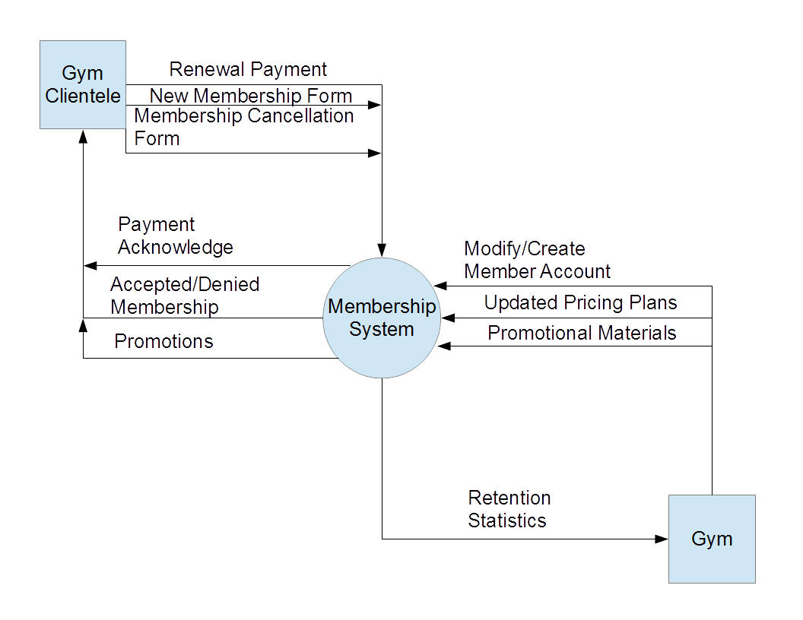

Slide 14
EVER HEALTH INTERVIEW SCHEDULE
GYM CEO – Jason Zander
Location: CEO’s Office
Time: Scheduled Appointment
Questions:
How do you feel your operation is running as of now? What parts of that do you think could be fixed with a new information system?
What statement would you like this newly implemented system to make?
What are your top priorities when it comes to the average member?
What information would you like the new system to compile?
What would the ideal situation of your business look like after the system has been implemented?

Slide 15
EVER HEALTH INTERVIEW SCHEDULE
GYM MANAGERS – most profitable/least profitable locations
Location: Local Gym Offices
Time: Scheduled Day Appointment
Questions:
What day to day problems do you experience?
What are the most common complaints that you experience?
How do you feel your operation is running as of now? What parts of that do you think could be fixed with a new information system?
What would the ideal, day to day situation of your business look like after the system has been implemented?

Slide 16
EVER HEALTH INTERVIEW SCHEDULE
ALL GYM MEMBERS – anonymous survey
Location: N/A
Time: N/A
Questions:
What do you feel that your gym handles well
What are the areas that the gym is lacking in?
Would you prefer to register, renew, or cancel your membership online?
What improvements would you like to see with the website?
What information would you like available to you?

Slide 17
Project Schedule

Slide 18
Eagles Consulting
10/31/2016
2016
09/11
09/18
09/25
10/02
10/09
10/16
10/23
10/30
2016
5 days
Today
System Design
9/13/16 - 9/19/16
5 days
Creation of Financial System
9/20/16 - 9/26/16
5 days
Creation of Database Sytem
9/27/16 - 10/3/16
5 days
Excell Integration
10/4/16 - 10/10/16
5 days
Business Documents
10/11/16 - 10/17/16
5 days
Advertising Materials
10/18/16 - 10/24/16
5 days
Website Development
10/25/16 - 10/31/16

Slide 19
5 days
Report Creation
11/1/16 - 11/7/16
5 days
System Testing
11/8/16 - 11/14/16
5 days
Training
11/15/16 - 11/21/16
5 days
System Development Part 1
11/22/16 - 11/28/16
5 days
System Development Part 2
11/29/16 - 12/5/16
5 days
System Development Part 3
12/6/16 - 12/12/16
1 day
Presentation
12/13/16
Eagles Consulting
12/12/2016
2016
10/30
11/06
11/13
11/20
11/27
12/04
12/11
2016
Today

Slide 20
Timeline: 9/13/2016 - 12/12/2016
Milestone(s)
Date | Description
12/12/2016 | Eagles Consulting
Task(s)
Duration (days) | Start Date | End Date | Description
7 | 09/13/2016 | 09/19/2016 | System Design
7 | 09/20/2016 | 09/26/2016 | Creation of Financial System
7 | 09/27/2016 | 10/03/2016 | Creation of Database Sytem
7 | 10/04/2016 | 10/10/2016 | Excell Integration
7 | 10/11/2016 | 10/17/2016 | Business Documents
7 | 10/18/2016 | 10/24/2016 | Advertising Materials
7 | 10/25/2016 | 10/31/2016 | Website Development
7 | 11/01/2016 | 11/07/2016 | Report Creation
7 | 11/08/2016 | 11/14/2016 | System Testing
7 | 11/15/2016 | 11/21/2016 | Training
7 | 11/22/2016 | 11/28/2016 | System Development Part 1
7 | 11/29/2016 | 12/05/2016 | System Development Part 2
7 | 12/06/2016 | 12/12/2016 | System Development Part 3
1 | 12/13/2016 | 12/13/2016 | Presentation

Slide 21
Risk Management Plan
Risk | Probability | Impact | Owner | Mitigation Plan
Budget cuts may reduce staff, affecting project scope and schedule | Medium | High | Project Manager | See appendix for a phased implementation plan

Slide 22
Quality Management and Performance Measures
Define quality management plans
How will you monitor and control costs?
How will you monitor and control schedule?
Notes:
May require more than one slide

Slide 23
Appendix
Reference supplementary materials and resources

Slide 24
Project Scope
Describe the work to be accomplished
What’s the purpose or business need for this project?
Is there a relationship to other projects?
Who are the stakeholders?
What work is out of scope for this project?
Notes:
May require more than one slide

Slide 25
Success Factors
Identify elements that are key to the success of the project, such as:
Satisfied clients or stakeholders
Met project objectives
Completed within budget
Delivered on time

Slide 26
Implementation
Tasks/activities
Procedures
Tools/technology
Project change control process
DYA: define your acronyms!
Notes:
May require more than one slide

Slide 27
Resources
People
Resource 1 Resource 2 Resource 3 Resource 4
Equipment
Resource 1 Resource 2 Resource 3 Resource 4
Notes
Locations
Resource 1 Resource 2 Resource 3 Resource 4
Outside Services
Notes
Notes
Resource 1 Resource 2 Resource 3 Resource 4
Notes
Manufacturing
Resource 1 Resource 2 Resource 3 Resource 4
Notes
Sales
Resource 1 Resource 2 Resource 3 Resource 4
Notes

Slide 28
Cost Analysis

